Slide 1


Towards Improving Binary Black Hole Simulations Using Compact Finite Differences
James Bleazard, Luke Papenfuss, Nathanael Garey, Eric Hirschmann, David Neilsen, William Black, Andrew Carroll, David Van Komen
Notes:
Blocks:
-Intro to GW and Dendro - Nate
-Numerical methods and accuracy - Luke
-Stability and future work - James

Slide 2
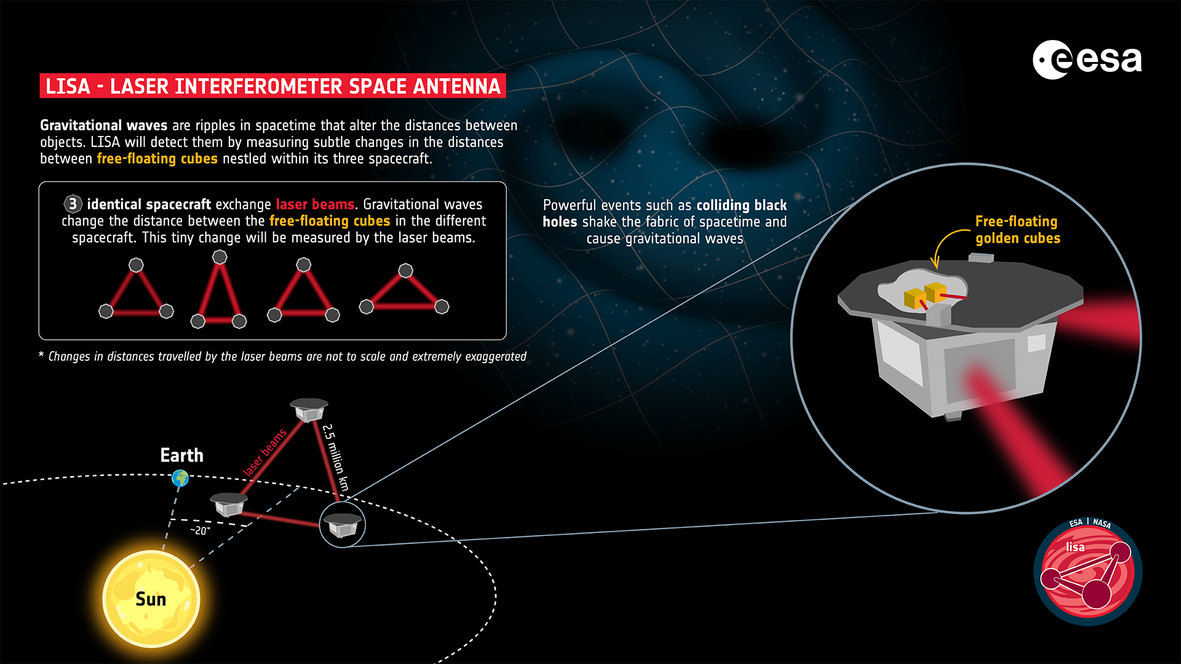
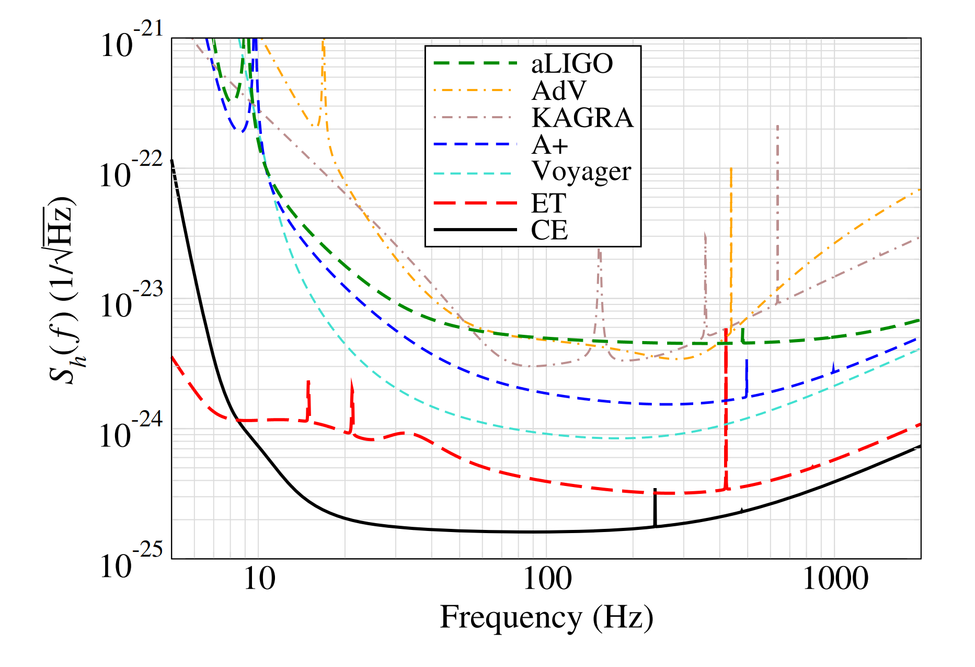
Goals and Motivation
New gravitational wave (GW) detectors are being built or proposed with increasing sensitivity
Fast and accurate black hole merger simulations and waveforms are needed
European Space Agency (ESA)
Regimbau et al. (https://doi.org/10.48550/arXiv.1611.08943)
Notes:
LISA is being built; ET and CE are still in proposal phases. Mention setup of LISA in figure on the left, for figure on the right, mention that we are looking at a log scale of detector sensitivity at different frequencies (size of BBH mergers).

Slide 3
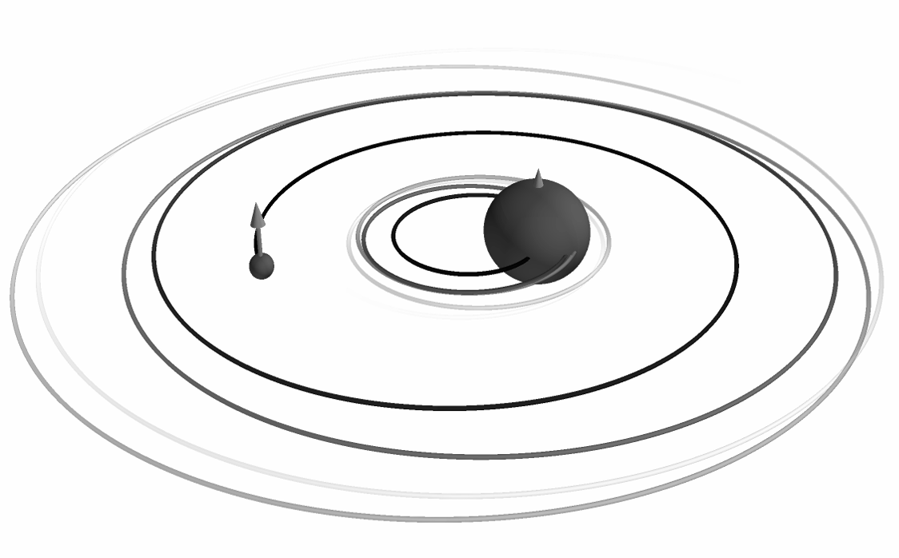
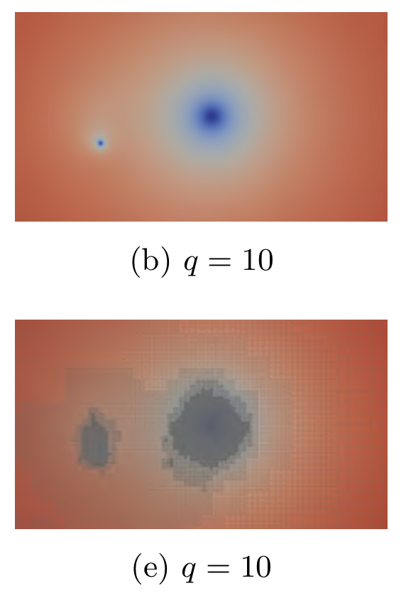
Current Modeling Challenges
Additional factors increase computational costs:
Mass Ratio
Spin
Eccentricity
Charge
Adapted from Fernando et al. (https://doi.org/10.48550/arXiv.1807.06128)
Deborah Ferguson (LISA Symposium 2024)
Notes:
Figure on the left shows a q=10 merger (quantity is “spatial curvature” roughly speaking), figure in the middle shows how much more refinement is needed for this higher mass ratio merger (each refinement level corresponds with more computational time), figure on the right shows a BBH inspiral where the orbit is not perfectly circular, and this takes more computation time to model (we want to circularize the orbits).

Slide 4
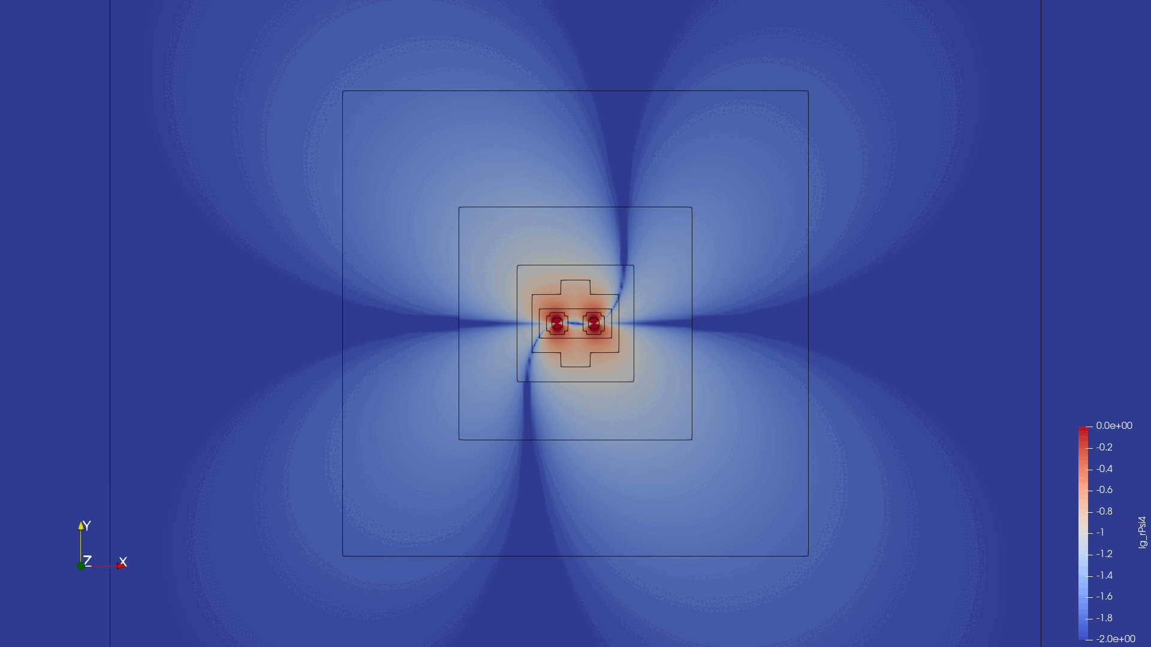
Dendro-GR
Numerical relativity codes solve the Einstein field equations to produce a gravitational wave waveform
William Black (BYU)
Notes:
Point out that this (psi4) is the actual gravitational wave produced by an inspiral

Slide 5
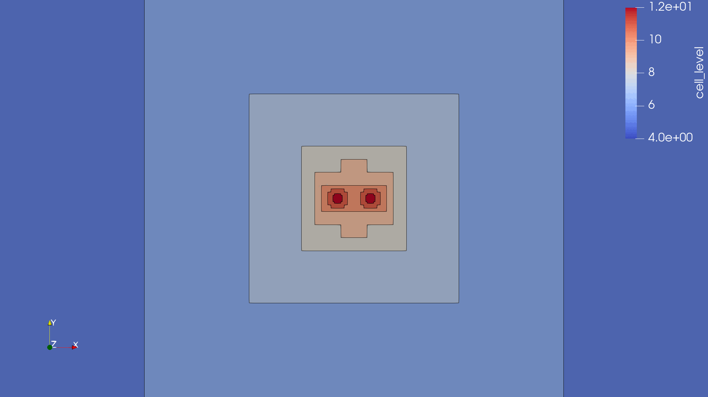
Dendro-GR
Dendro-GR performs binary black hole simulations with Wavelet Adaptive Multiresolution (WAMR)
Less refinement is needed in the grid where information hasn’t yet propagated
We are implementing our methods with hope to improve accuracy and communication between processing units
William Black (BYU)
Notes:
Big thing to notice is that we’re basically saying we need more points to be accurate near the black holes

Slide 6
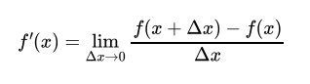
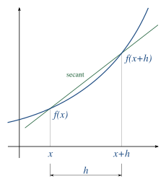
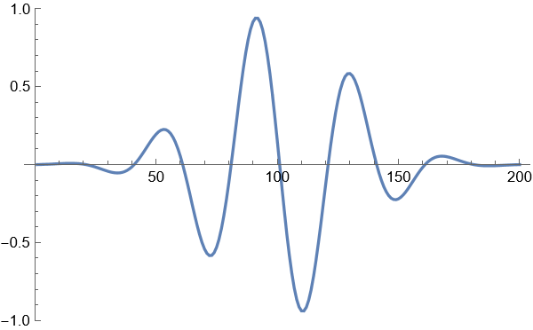
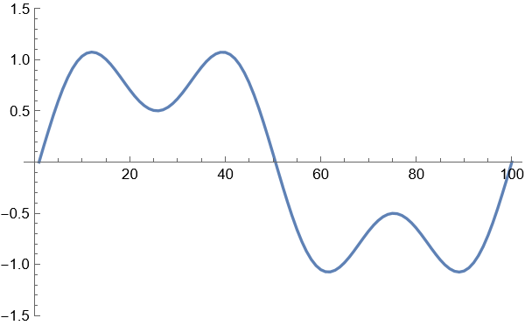
Numerical Methods
Derivative approximations can be calculated using discrete points on the function
The limit definition of the derivative can be altered to give a finite approximation of the derivative
Solutions to differential equations can be approximated using these derivative schemes as differential operators
Wikipedia contributors, "Numerical differentiation”

Slide 7
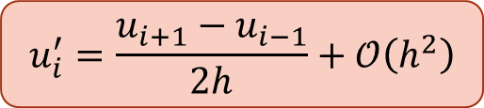
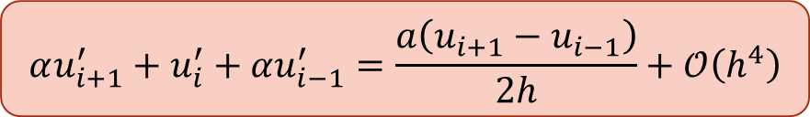
Explicit vs. Compact Schemes
Compact Finite Difference (CFD) schemes can be derived from a Taylor expansion
CFD schemes come with an additional computational cost of matrix inversion, but fast inversion methods exist
Our current efforts focus on finding stable and highly accurate CFD schemes
Explicit Scheme
Implicit/Compact Scheme
$$u_{i}^{′}=\frac{u_{i+1}−u_{i−1}}{2h}+𝒪\left(h^{2}\right)$$
$$αu_{i+1}^{′}+u_{i}^{′}+αu_{i−1}^{′}=\frac{a\left(u_{i+1}−u_{i−1}\right)}{2h}+𝒪\left(h^{4}\right)$$
Notes:
CFD schemes can achieve higher accuracy with less points

Slide 8
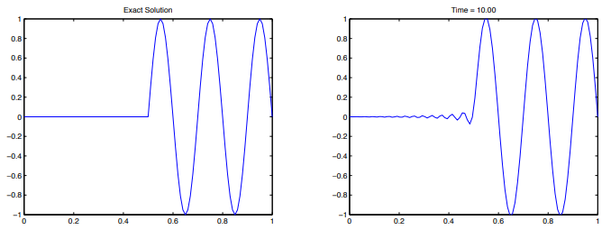
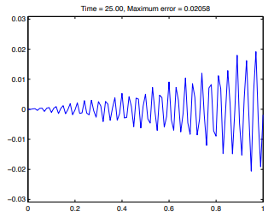
Accuracy and Stability
CFD schemes are generated from the Taylor expansions and other additional correcting methods
A scheme is only useful based on accuracy and stability
Accuracy: How well the scheme converges to the true derivative
Stability: The convergence of the approximate solution over time
Tyler, Jonathan G., "Analysis and Implementation of High-Order Compact Finite Difference Schemes" (2007)

Slide 9
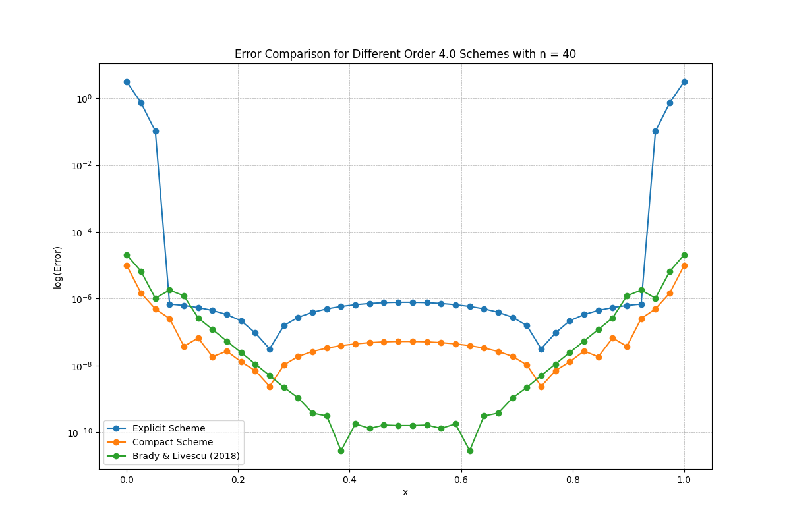
Accuracy Improvement of CFD Schemes
Notes:
Emphasize that boundary error is bad for an explicit scheme, but compact scheme improves by 4-5 orders of magnitude on the boundary. With some additional techniques, we can get another 3-4 orders of magnitude on the interior.

Slide 10
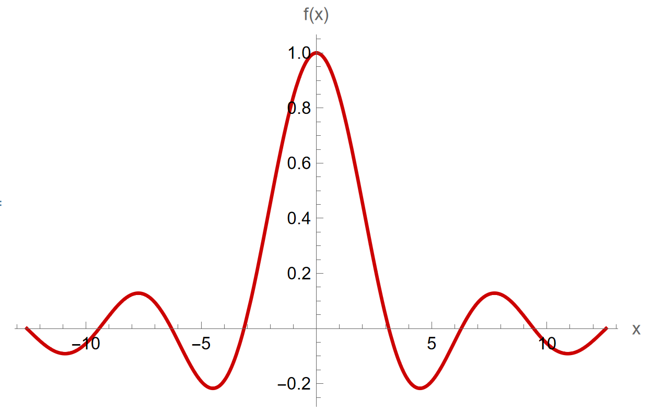
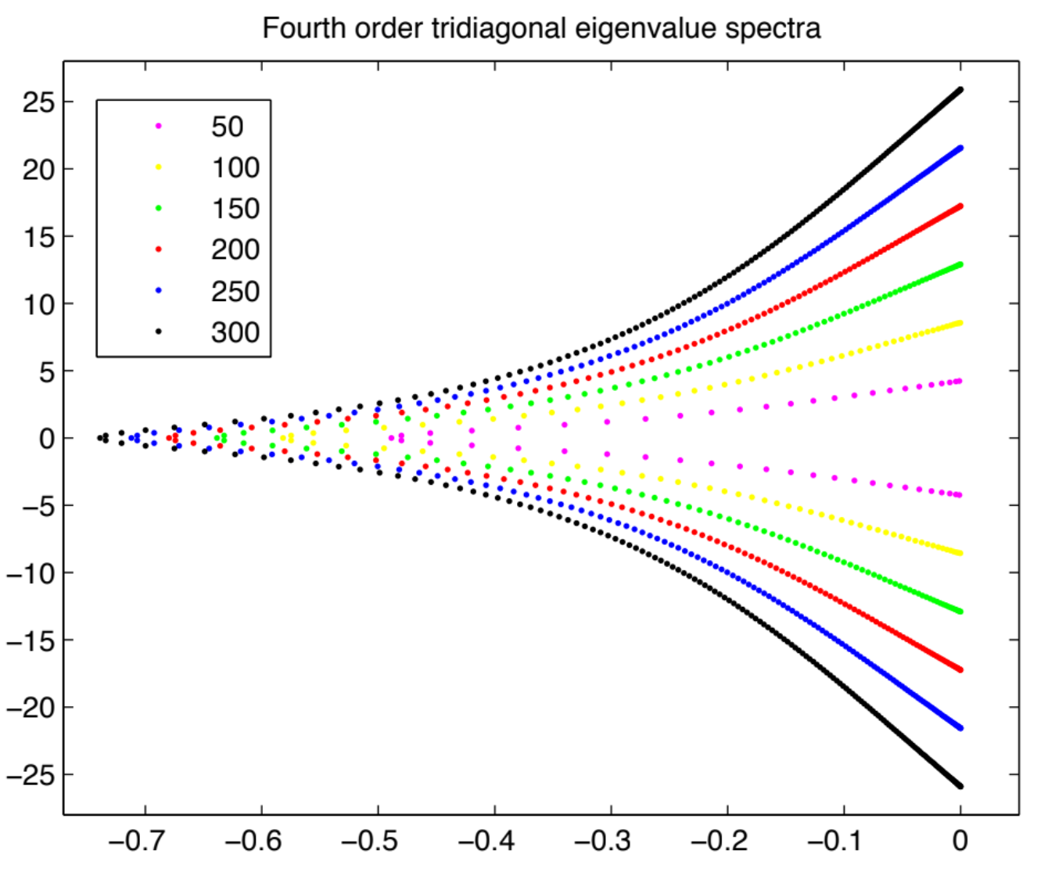
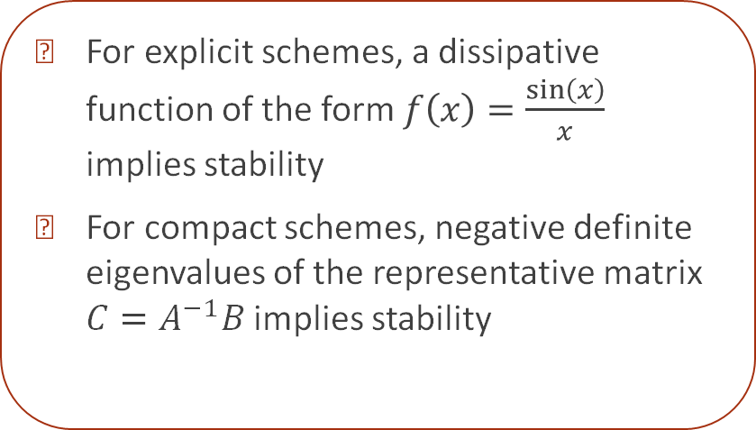

Analytic Approach to Stability
For explicit schemes, a dissipative function of the form $f\left(x\right)=\frac{\sin\left(x\right)}{x}$ implies stability
For compact schemes, negative definite eigenvalues of the representative matrix $C=A^{−1}B$ implies stability
Dissipative Function $f\left(x\right)=\frac{\sin\left(x\right)}{x}$
Tyler, Jonathan G., "Analysis and Implementation of High-Order Compact Finite Difference Schemes" (2007).
Notes:
We can perform a Fourier/von Neumann analysis for different schemes

Slide 11
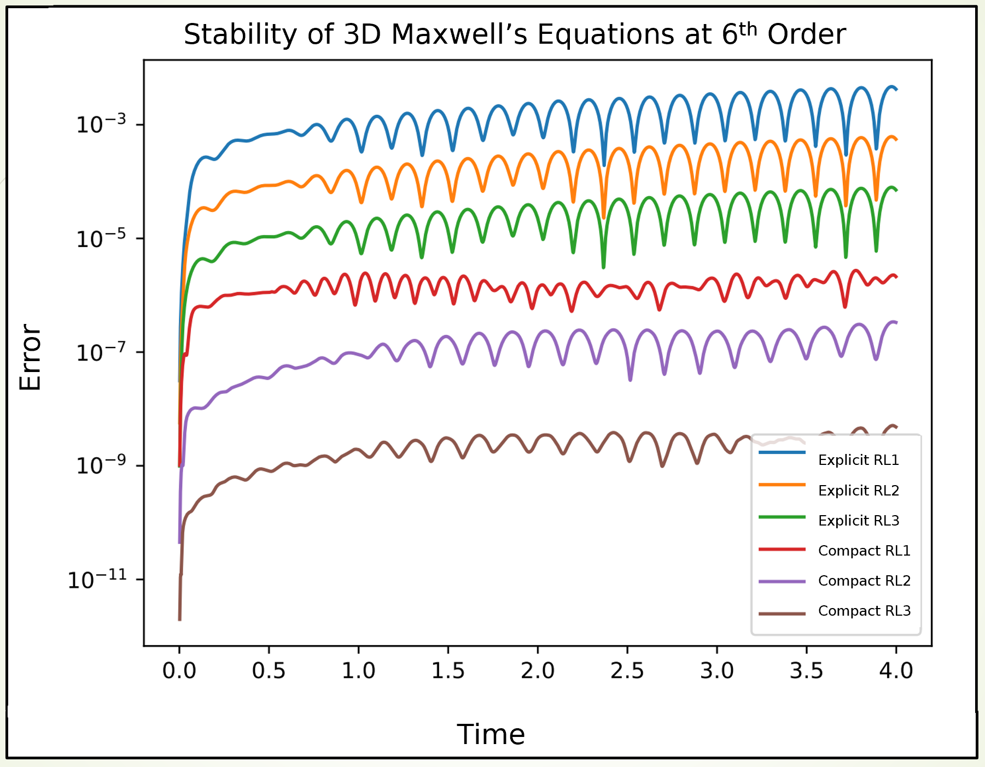
Time Stability of Compact Schemes
David Neilsen and Andrew Carroll (BYU)
Notes:
Emphasize refinement levels; lowest refinement compact is more accurate than highest refinement explicit. Flatness over time implies stability. The bumps are a natural part of the EM equations because their solutions are standing waves.

Slide 12
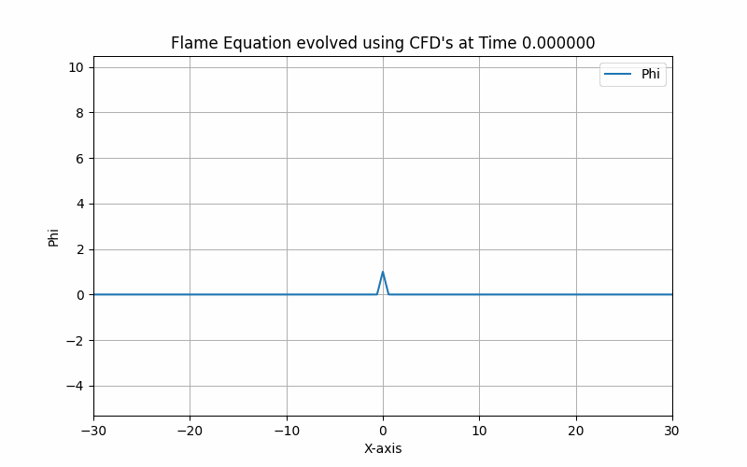
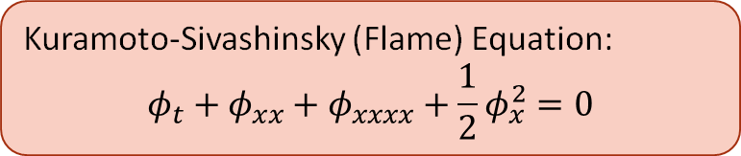
Nonlinear Stability of Compact Schemes
Andrew Carroll (BYU)
Kuramoto-Sivashinsky (Flame) Equation:
$$φ_{t}+φ_{xx}+φ_{xxxx}+\frac{1}{2}φ_{x}^{2}=0$$
Notes:
Emphasize that this is bounded, implying stability over time. Emphasize that this includes high-order derivatives and a nonlinear term, so this is promising for CFDs.

Slide 13
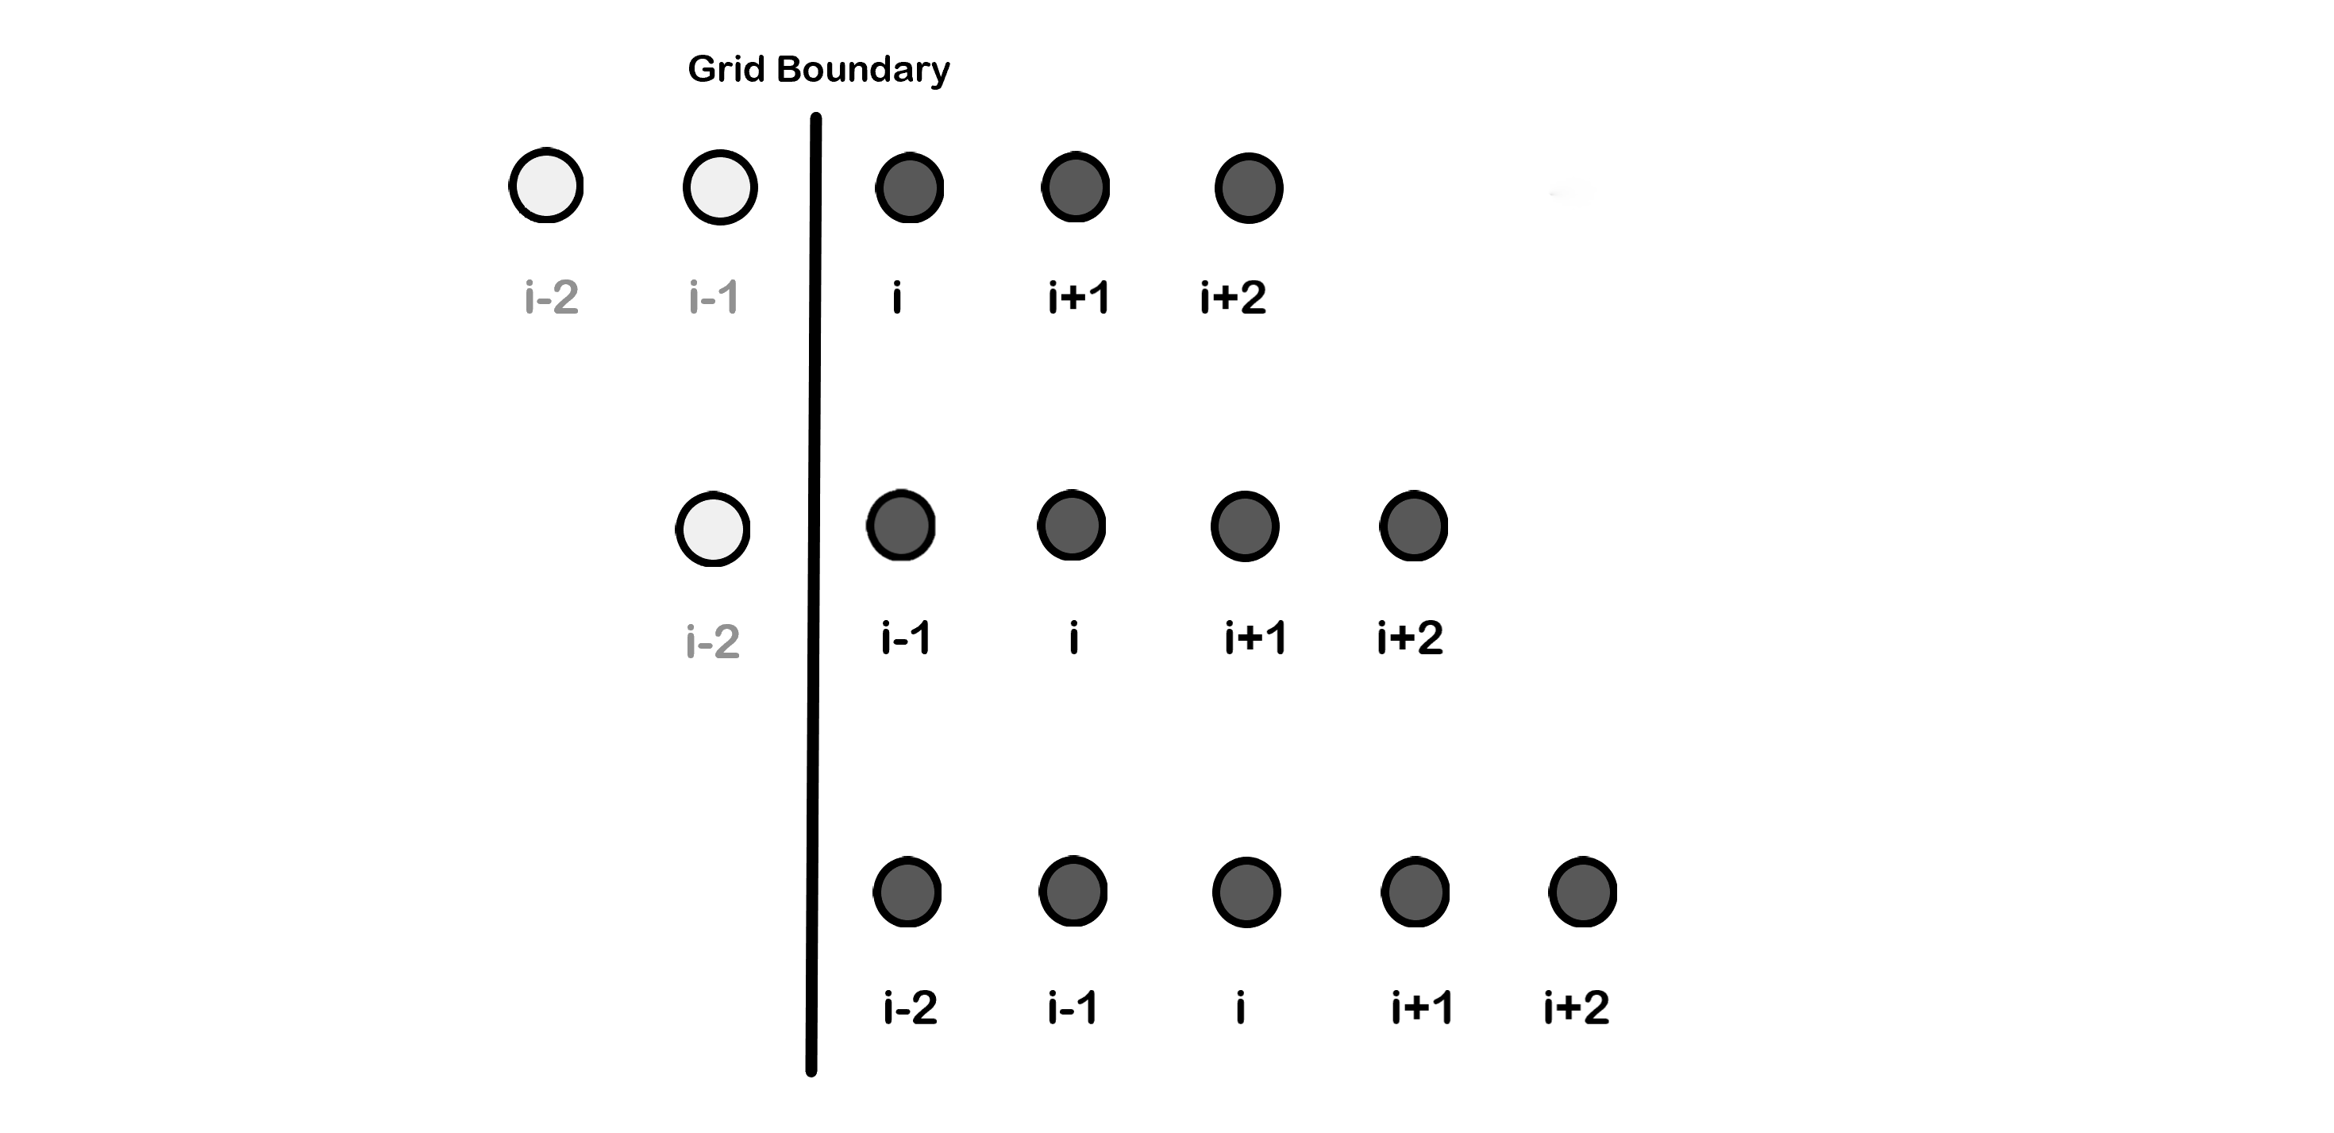
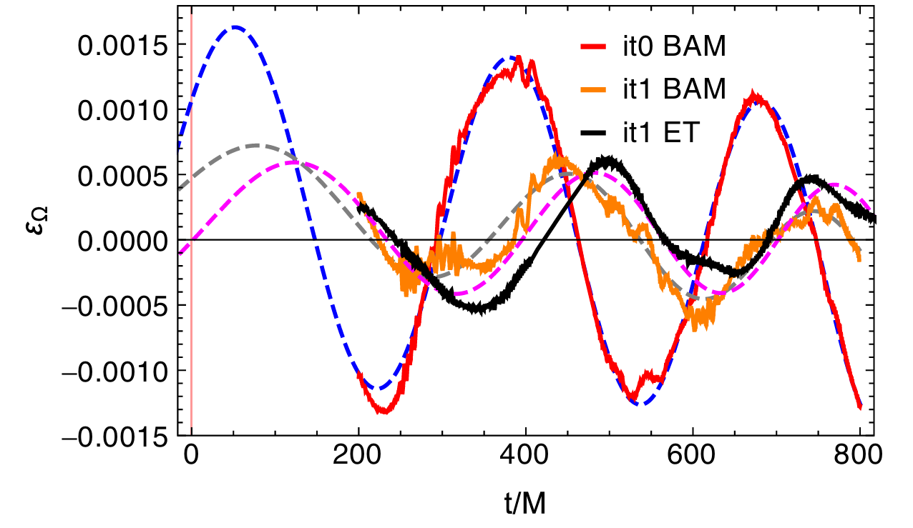
Future Work
Stable CFD schemes
Improved boundary methods
Eccentricity reduction
Filtering techniques
Ramos-Buades et al. (https://doi.org/10.48550/arXiv.1810.00036)
Notes:
Continue to find stable CFD schemes for higher orders of accuracy
Continue analytic work to show that schemes are stable and discover where instabilities arise
Implement boundary interpolation methods to improve accuracy on boundary points
Implement methods to reduce eccentricity and save on computational time
Use filtering techniques to further increase stability without sacrificing accuracy

Slide 14

Acknowledgements
Thank you to the audience for listening to our presentation!
Thank you to Dr. Eric Hirschmann, Dr. David Neilsen, and Dr. William Black for their mentorship and help with research efforts.
Thank you to the National Science Foundation (NSF-PHY 2207615) and Brigham Young University for their funding in support of our research efforts.

